Slide 1
Estimating QoE from QoS in real-time traffic: a Machine Learning approach
Master Degree in
COMMUNICATIONS AND COMPUTER NETWORKS
ENGINEERING
Supervisor: Prof. Martino Trevisan
Co-Supervisors: Prof. Michela Meo
Dena Markudova
Candidate: Ymer Gurra

Slide 2
Outline
I
Introduction
II
Goals and Objectives
III
Scenario and Methodology
VI
Dataset description
V
Results and Discussion
VI
Conclusions

Slide 3

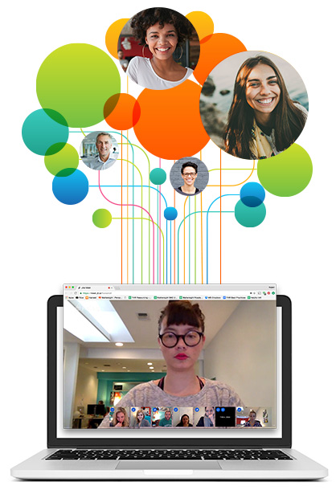




Introduction
Video streaming
Quality of Experience (QoE) evaluation
Network Operators / ISP providers:
QoE metrics such as video quality, freezing etc.
Only network level measurements such as:
Delay
Jitter
Throughput etc.

Slide 4


Goals and Objectives
Mapping QoS parameters into QoE metrics
Build a Machine Learning model
Test and improve the model’s performance

Slide 5




Thesis Workflow
DATA PRE-PROCESSING
DATA COLLECTION
Statistic producer tool
ONLINE MEETING
Wireshark
QoS-QoE mapping via ML approach
Performance evaluation
App logs
via JITSI
QoS features
Number of samples (1s):
Total 403 264
Train 284 243 (70%)
Test 119 021 (30%)
Mean
Min
Max
Standard deviation etc.
f-1 score
WebRTC
QoE features
Mean Absolute Error
50 pcaps (50 GB of data)
Classification
Regression

Slide 6



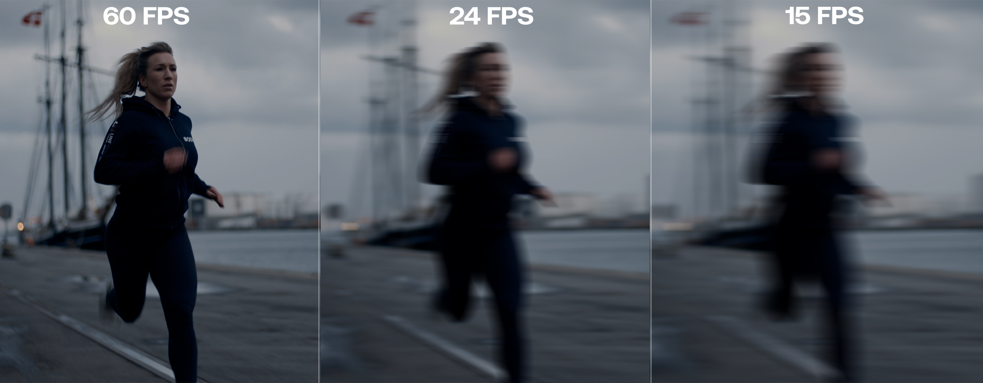


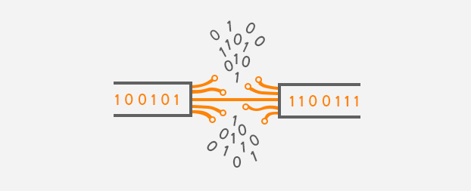
Feature Description
QoS features categories:
a) Interarrival: The time difference between 2 successfully received consecutive packets in a UDP stream
b) Packet length: The size of a packet
c) Interlength: The difference between the lengths of 2 successfully received consecutive packets in a UDP stream.
d) Inter RTP timestamp: Difference between consecutive RTP timestamps
Packet level statistics:
Mean
Standard deviation
Percentiles
Skewness
Kurtossis etc.
QoE metrics (targets):
Resolution : The size in pixels of the received video frames
Smoothness : The number of frames per second perceived at the user side
Concealment : Time spent by the decoder rendering frames that are partially received

Slide 7


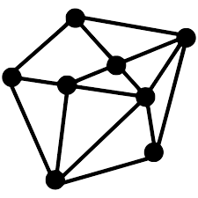
Supervised ML approach
QoS features
Interarrival (std) | Packet length(kbps) | Interlength (max) | Rtp_int_timestamp (count)
0.002851 | 37.945312 | 9.0 | 50
0.003035 | 38.687500 | 9.0 | 50
0.002728 | 36.945312 | 6.0 | 50
0.004631 | 36.656250 | 26.0 | 50
Model training
Output (ex.)
Processing
Resolution = 240.0
Smoothness = 3.0
Audio Conceal. = 0.0
Video Conceal. = 1.0
Target-3
Target-1
Target-2
Resolution (pixels) | Smoothness (fps) | Audio Conceal. | Video Conceal.
320.0 | 30.0 | 0.0 | 0.0
1280.0 | 10.0 | 5.0 | 1.0
240.0 | 9.0 | 2.0 | 0.0
Test data sample
0.00157 | 32.7543 | 5.0 | 50
Algorithm

Slide 8
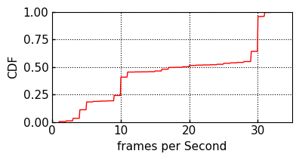



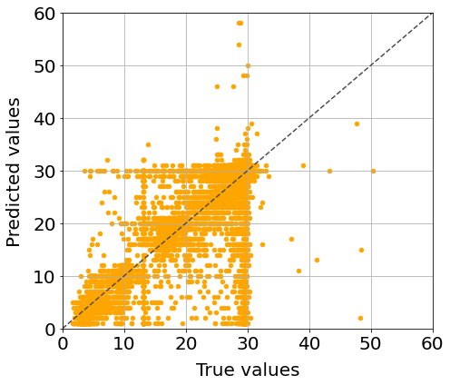
Smoothness Prediction
Feature selection
Coefficient correlation
DATA PRE-PROCESSING
Information Gain
Anova f-value
dataset
Flooring and capping
Trimming
Replacement with median
Outlier treatment
Model | R-squared (R2) | MSE | MAE
Random Forest | 0.87 | 15.02 | 1.43
Decision Tree | 0.84 | 19.0 | 1.64

Slide 9
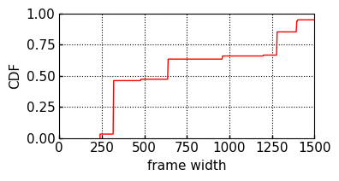
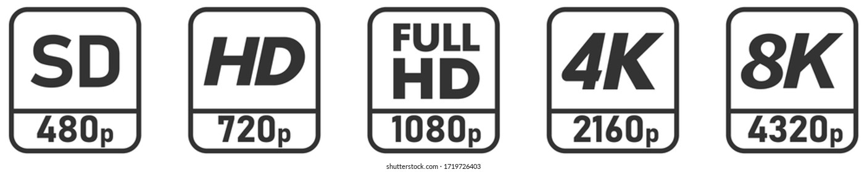
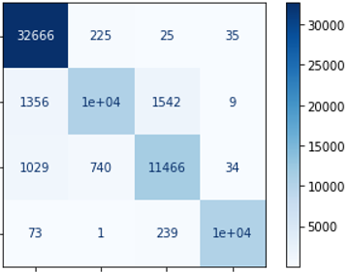
Resolution Prediction
240 – 480
480 – 960
960 – 1280
> 1280
Model | Precision | Recall | f1-score
Random Forest | 0.93 | 0.90 | 0.91
XG Boost | 0.93 | 0.90 | 0.91
Decision Tree | 0.91 | 0.89 | 0.90
True values
Predicted values

Slide 10
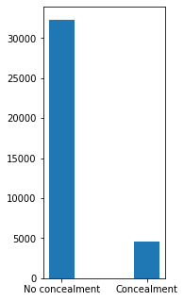
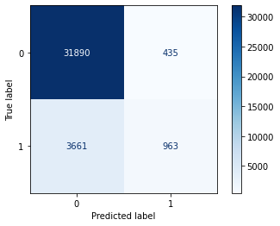
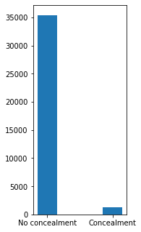
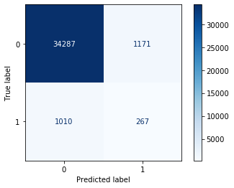
Concealment Prediction
Audio concealment:
Model | Precision | Recall | f1-score
Random Forest | 0.80 | 0.61 | 0.64
Decision Tree | 0.60 | 0.60 | 0.60
No. of supports
Video concealment:
No. of supports
Model | Precision | Recall | f1-score
Random Forest | 0.58 | 0.59 | 0.59
Decision Tree | 0.59 | 0.61 | 0.60

Slide 11





Conclusions
Our model is able to predict the following targets:
Smoothness
Resolution
Concealment
Some approaches for concealment improvement:
Collect more data
Imbalanced classification techniques: SMOTE, MSMOTE etc.
Observations from a cloud gaming scenario:
Only one resolution class
Only one value of smoothness
Very few concealments
Different targets need to be defined for this scenario

Slide 12


Thank you

